Slide 1
Advanced Javascript
Day 2- JS Constructors, Call, Apply, Bind

Slide 2

Creating Objects

Slide 3
How do we create objects in Javascript.
var person = {} //object literal

Slide 4
But, there is one problem with creating objects through previous methods.

Slide 5
What if someone told you to create 100 objects?

Slide 6
We need a better way to create multiple objects of same type!

Slide 7
JS Constructors

Slide 8
What are Constructors?
Construct- To build something new or To create something from scratch
The constructor method in JavaScript is a special function used to create objects.

Slide 9
Js Constructor functions
We have to provide a blueprint of what key value pair an object should have.
To do that, we use functions.

Slide 10
But first

Slide 11
Who is the owner of a key value pair?
var person = {
name: ‘John’,
}

Slide 12
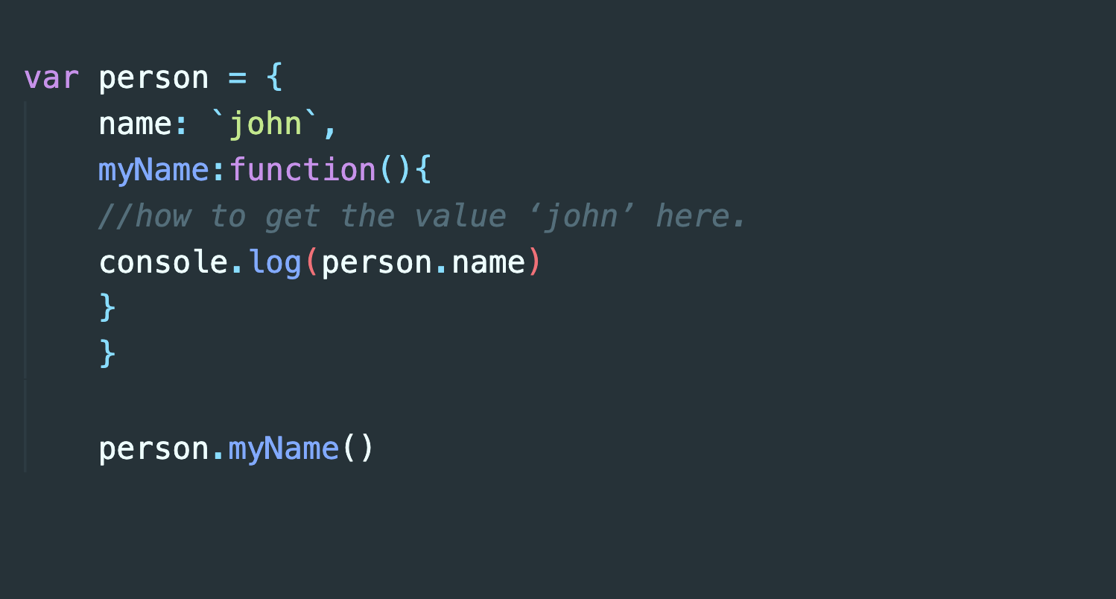

Slide 13
Introduction to this
‘this’ refers to owner object
this inside functions
this inside function methods

Slide 14
The value of this is determined by how the function was executed:
In a method (function written inside an object), this refers to the owner object.
Alone, this refers to the global object.
In a function, this refers to the global object.

Slide 15
‘this’ helps us create objects using functions.

Slide 16
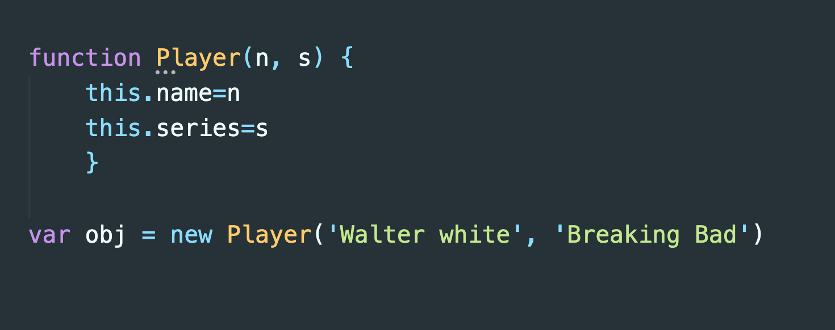
function Player(n, s) {
this.name=n
this.series=s
}
var obj = new Player ( “Walter white” , “Breaking Bad”)

Slide 17
So, how did we move from simple functions that return values to creating objects using them…
It’s all because of ‘this’ and ‘new’ keywords.

Slide 18
Js Constructor functions
Important things to remember
‘new’ keyword is mandatory
You can also pass function as argument values
Best used for creating multiple objects of same type

Slide 19
We learned about creating custom Objects using Js functions

Slide 20

What if we could control where ‘this’ belongs?

Slide 21
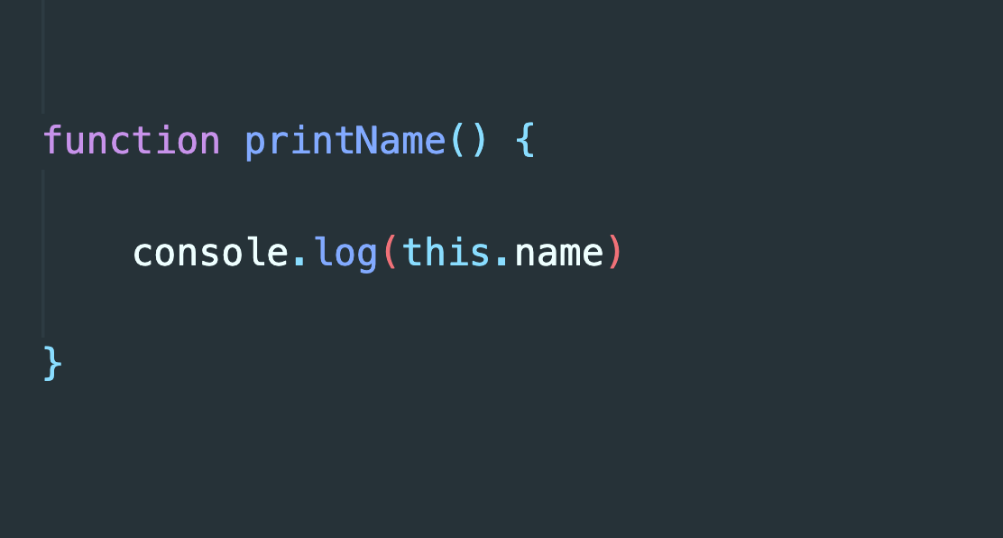
function Player(n, s) {
this.name=n
this.series=s
}
var obj = new Player ( “Walter white” , “Breaking Bad”)

Slide 22
Call, Apply, Bind

Slide 23
All JavaScript functions has access to some very special methods which we can use to control where ‘this’ should refer.
Such methods are call(), bind() & apply().

Slide 24
Call()
call() provides a new value of ‘this’ to the function/method.

Slide 25
Apply()
The apply() method is literally the same as call() method.
They just both take arguments differently.
Call() takes individual arguments separated by comma.
printBio.call(obj, 20, ‘Pune’)
apply() takes a single array of arguments.
printBio.apply(obj, [ 20, ‘Mumbai’])

Slide 26
Bind()
You can bind a particular object as ‘this’ to a function and use it later.
You cannot use call() or apply() later, they run immediately.

Slide 27
Let’s Recap

Slide 28
this -

Slide 29
Function Constructors

Slide 30
Call, Apply

Slide 31
Bind

